Slide 1
Chapter 2:
Java Fundamentals
Starting Out with Java:
From Control Structures through Objects
Fourth Edition
by Tony Gaddis
Notes:
CHAPTER 2
Java Gaddis 4/e

Slide 2
Chapter Topics
Chapter 2 discusses the following main topics:
  The Parts of a Java Program
  The print and println Methods, and the Java API
  Variables and Literals
  Primitive Data Types
  Arithmetic Operators
  Combined Assignment Operators
2-<number>
Notes:
CHAPTER 2
Java Gaddis 4/e

Slide 3
Chapter Topics (2)
  Creating named constants with final
  The String class
  Scope
  Comments
  Programming style
  Using the Scanner class for input
  Dialog boxes
2-<number>
Notes:
CHAPTER 2
Java Gaddis 4/e

Slide 4
Parts of a Java Program
A Java source code file contains one or more Java classes.
If more than one class is in a source code file, only one of them may be public.
The public class and the filename of the source code file must match.
    ex: A class named Simple must be in a file named Simple.java
Each Java class can be separated into parts.
2-<number>
Notes:
CHAPTER 2
Java Gaddis 4/e

Slide 5
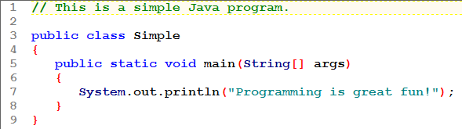

Parts of a Java Program
See example: Simple.java
Opened in TextPad, use the Tools/External Tools menu to Compile Java Program and then to Run Java Application.
2-<number>
Notes:
CHAPTER 2
Java Gaddis 4/e

Slide 6
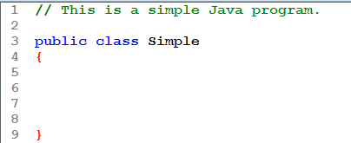
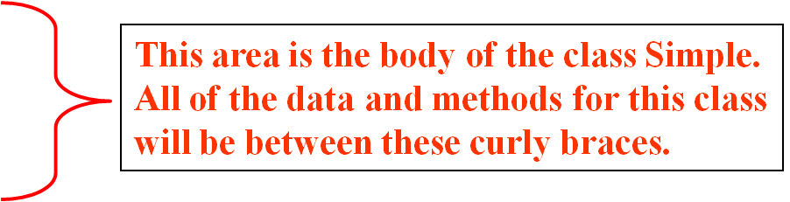
Analyzing The Example
This is a Java comment. It is ignored by the compiler.
This is the class header
for the class Simple
2-<number>

Slide 7
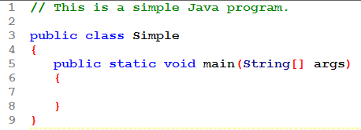
Analyzing The Example
This is the method header
for the main method. The
main method is where a Java
application begins.
This area is the body of the main method.
All of the actions to be completed during
the main method will be between these curly braces.
2-<number>

Slide 8
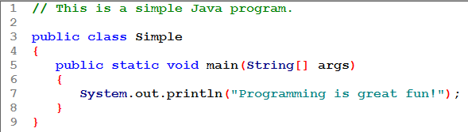
Analyzing The Example
This is the Java Statement that
is executed when the program runs.
2-<number>

Slide 9
Parts of a Java Program
Comments
  The line is ignored by the compiler.
  The comment in the example is a single-line comment.
Class Header
  The class header tells the compiler things about the class such as what other classes can use it (public) and that it is a Java class (class), and the name of that class (Simple).
Curly Braces
  When associated with the class header, they define the scope of the class.
  When associated with a method, they define the scope of the method.
2-<number>
Notes:
CHAPTER 2
Java Gaddis 4/e

Slide 10
Parts of a Java Program
The main Method
  This line must be exactly as shown in the example (except the args variable name can be programmer defined).
  This is the line of code that the java command will run first.
  This method starts the Java program.
  Every Java application must have a main method.
Java Statements
  When the program runs, the statements within the main method will be executed.
  Can you see what the line in the example will do?
2-<number>
Notes:
CHAPTER 2
Java Gaddis 4/e

Slide 11
Java Statements
If we look back at the previous example, we can see that there is only one line that ends with a semi-colon.
  System.out.println("Programming is great fun!");
This is because it is the only Java statement in the program.
The rest of the code is either a comment or other Java framework code.
2-<number>
Notes:
CHAPTER 2
Java Gaddis 4/e

Slide 12
Java Statements
Comments are ignored by the Java compiler so they need no semi-colons.
Other Java code elements that do not need semi colons include:
  class headers
    Terminated by the code within its curly braces.
  method headers
    Terminated by the code within its curly braces.
  curly braces
    Part of framework code that needs no semi-colon termination.
2-<number>
Notes:
CHAPTER 2
Java Gaddis 4/e

Slide 13
Short Review
Java is a case-sensitive language.
All Java programs must be stored in a file with a .java file extension.
Comments are ignored by the compiler.
A .java file may contain many classes but may only have one public class.
If a .java file has a public class, the class must have the same name as the file.
2-<number>
Notes:
CHAPTER 2
Java Gaddis 4/e

Slide 14
Short Review
Java applications must have a main method.
For every left brace, or opening brace, there must be a corresponding right brace, or closing brace.
Statements are terminated with semicolons.
  Comments, class headers, method headers, and braces are not considered Java statements.
2-<number>
Notes:
CHAPTER 2
Java Gaddis 4/e

Slide 15
Special Characters
// | double slash | Marks the beginning of a single line comment.
( ) | open and close parenthesis | Used in a method header to mark the parameter list.
{ } | open and close curly braces | Encloses a group of statements, such as the contents of a class or a method.
“ ” | quotation marks | Encloses a string of characters, such as a message that is to be printed on the screen
; | semi-colon | Marks the end of a complete programming statement
2-<number>
Notes:
CHAPTER 2
Java Gaddis 4/e

Slide 16
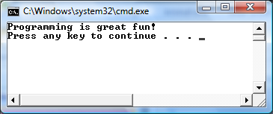
Console Output
Many of the programs that you will write will run in a console window.
2-<number>
Notes:
CHAPTER 2
Java Gaddis 4/e

Slide 17
Console Output
The console window that starts a Java application is typically known as the standard output device.
The standard input device is typically the keyboard.
Java sends information to the standard output device by using a Java class stored in the standard Java library.
2-<number>
Notes:
CHAPTER 2
Java Gaddis 4/e

Slide 18
Console Output
Java classes in the standard Java library are accessed using the Java Applications Programming Interface (API).
The standard Java library is commonly referred to as the Java API.
2-<number>
Notes:
CHAPTER 2
Java Gaddis 4/e

Slide 19
Console Output
The previous example uses the line:
  System.out.println("Programming is great fun!");
This line uses the System class from the standard Java library.
The System class contains methods and objects that perform system level tasks.
The out object, a member of the System class, contains the methods print and println.
2-<number>
Notes:
CHAPTER 2
Java Gaddis 4/e

Slide 20
Console Output
The print and println methods actually perform the task of sending characters to the output device.
The line:
  System.out.println("Programming is great fun!");
  is pronounced: System dot out dot println …
The value inside the parenthesis will be sent to the output device (in this case, a string).
2-<number>
Notes:
CHAPTER 2
Java Gaddis 4/e

Slide 21
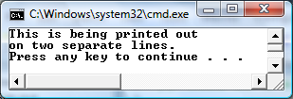
Console Output
The println method places a newline character at the end of whatever is being printed out.
The following lines:
    System.out.println("This is being printed out");
    System.out.println("on two separate lines.");
  Would be printed out on separate lines since the first statement sends a newline command to the screen.
2-<number>
Notes:
CHAPTER 2
Java Gaddis 4/e

Slide 22

Console Output
The print statement works very similarly to the println statement.
However, the print statement does not put a newline character at the end of the output.
The lines:
    System.out.print("These lines will be");
    System.out.print("printed on");
    System.out.println("the same line.");
  Will output:
  Notice the odd spacing? Why are some words run together?
2-<number>
Notes:
CHAPTER 2
Java Gaddis 4/e

Slide 23
Console Output
For all of the previous examples, we have been printing out strings of characters.
Later, we will see that much more can be printed.
There are some special characters that can be put into the output.
System.out.print("This line will have a newline at the end.\n");
The \n in the string is an escape sequence that represents the newline character.
Escape sequences allow the programmer to print characters that otherwise would be unprintable.
2-<number>
Notes:
CHAPTER 2
Java Gaddis 4/e

Slide 24
Java Escape Sequences
\n | newline | Advances the cursor to the next line for subsequent printing
\t | tab | Causes the cursor to skip over to the next tab stop
\b | backspace | Causes the cursor to back up, or move left, one position
\r | carriage return | Causes the cursor to go to the beginning of the current line, not the next line
\\ | backslash | Causes a backslash to be printed
\' | single quote | Causes a single quotation mark to be printed
\” | double quote | Causes a double quotation mark to be printed
2-<number>
Notes:
CHAPTER 2
Java Gaddis 4/e

Slide 25
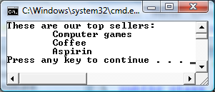
Java Escape Sequences
Even though the escape sequences are comprised of two characters, they are treated by the compiler as a single character.
    System.out.print("These are our top sellers:\n");
    System.out.print("\tComputer games\n\tCoffee\n ");
    System.out.println("\tAspirin");
Would result in the following output:
With these escape sequences, complex text output can be achieved.
2-<number>
Notes:
CHAPTER 2
Java Gaddis 4/e

Slide 26
Variables and Literals
A variable is a named storage location in the computer's memory.
A literal is a value that is written into the code of a program.
Programmers determine the number and type of variables a program will need.
See example:Variable.java
2-<number>
Notes:
CHAPTER 2
Java Gaddis 4/e

Slide 27
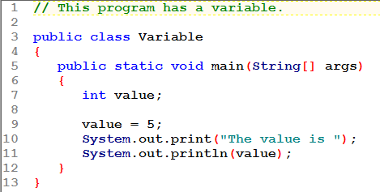


Slide 28
Variables and Literals
This line is called
a variable declaration.
int value;
The following line is known
as an assignment statement.
value = 5;
0x000
The value 5
is stored in
memory.
0x001
5
0x002
0x003
This is a string literal. It will be printed as is.
System.out.print("The value is ");
System.out.println(value);
The integer 5 will
be printed out here.
Notice no quote marks?
2-<number>

Slide 29
The + Operator
The + operator can be used in two ways.
  as a concatenation operator
  as an addition operator
If either side of the + operator is a string, the result will be a string.
  System.out.println("Hello " + "World");
  System.out.println("The value is: " + 5);
  System.out.println("The value is: " + value);
  System.out.println("The value is: " + '\n' + 5);
2-<number>
Notes:
CHAPTER 2
Java Gaddis 4/e

Slide 30
String Concatenation
Java commands that have string literals must be treated with care.
A string literal value cannot span lines in a Java source code file.
  System.out.println("This line is too long and now it has spanned more than one line, which will cause a syntax error to be generated by the compiler. ");
2-<number>
Notes:
CHAPTER 2
Java Gaddis 4/e

Slide 31

String Concatenation
The String concatenation operator can be used to fix this problem.
    System.out.println("These lines are " +
    "are now ok and will not " +
    "cause the error as before.");
String concatenation can join various data types.
    System.out.println("We can join a string to " +
    "a number like this: " + 5);
2-<number>
Notes:
CHAPTER 2
Java Gaddis 4/e

Slide 32
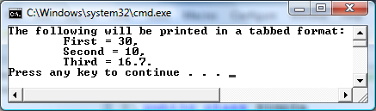
String Concatenation
The Concatenation operator can be used to format complex String objects.
    System.out.println("The following will be printed " +
    "in a tabbed format: " +
    "\n\tFirst = " + 5 * 6 + "," +
    "\n\tSecond = " + (6 + 4) + "," +
    "\n\tThird = " + 16.7 + ".");
Notice that if an addition operation is also needed, it must be put in parenthesis.
2-<number>
Notes:
CHAPTER 2
Java Gaddis 4/e

Slide 33
Identifiers
Identifiers are programmer-defined names for:
  classes
  variables
  methods
Identifiers may not be any of the Java reserved keywords.
2-<number>
Notes:
CHAPTER 2
Java Gaddis 4/e

Slide 34
Identifiers
Identifiers must follow certain rules:
  An identifier may only contain:
    letters a–z or A–Z,
    the digits 0–9,
    underscores (_), or
    the dollar sign ($)
  The first character may not be a digit.
  Identifiers are case sensitive.
    itemsOrdered is not the same as itemsordered.
  Identifiers cannot include spaces.
  $ has special significance, so we won't use it!
2-<number>
Notes:
CHAPTER 2
Java Gaddis 4/e

Slide 35
Java Reserved Keywords
abstract
assert
boolean
break
byte
case
catch
char
class
const
continue
default
do
double
else
enum
extends
false
for
final
finally
float
goto
if
implements
import
instanceof
int
interface
long
native
new
null
package
private
protected
public
return
short
static
strictfp
super
switch
synchronized
this
throw
throws
transient
true
try
void
volatile
while
2-<number>
Notes:
CHAPTER 2
Java Gaddis 4/e

Slide 36
Variable Names
Variable names should be descriptive.
Descriptive names allow the code to be more readable; therefore, the code is more maintainable.
Which of the following is more descriptive?
      double tr = 0.0725;
      double salesTaxRate = 0.0725;
Java programs should be self-documenting.
2-<number>
Notes:
CHAPTER 2
Java Gaddis 4/e

Slide 37
Java Naming Conventions
Variable names should begin with a lower case letter and then switch to title case thereafter:
    Ex: int caTaxRate
Class names should be all title case.
    Ex: public class BigLittle
More Java naming conventions can be found at:
  http://java.sun.com/docs/codeconv/html/CodeConventions.doc8.html
A general rule of thumb about naming variables and classes are that, with some exceptions, their names tend to be nouns or noun phrases.
2-<number>
Notes:
CHAPTER 2
Java Gaddis 4/e

Slide 38
Primitive Data Types
Primitive data types are built into the Java language and are not derived from classes.
There are 8 Java primitive data types.
  byte
  short
  int
  long
  float
  double
  boolean
  char
2-<number>
Notes:
CHAPTER 2
Java Gaddis 4/e

Slide 39
Numeric Data Types
byte | 1 byte | Integers in the range -128 to +127
short | 2 bytes | Integers in the range of -32,768 to +32,767
int | 4 bytes | Integers in the range of -2,147,483,648 to +2,147,483,647
long | 8 bytes | Integers in the range of -9,223,372,036,854,775,808 to +9,223,372,036,854,775,807
float | 4 bytes | Floating-point numbers in the range of ±3.4x10⁻³⁸ to ±3.4x10³⁸, with 7 digits of accuracy
double | 8 bytes | Floating-point numbers in the range of ±1.7x10⁻³⁰⁸ to ±1.7x10³⁰⁸, with 15 digits of accuracy
2-<number>
Notes:
CHAPTER 2
Java Gaddis 4/e

Slide 40
Variable Declarations
Variable Declarations take the following form:
  DataType VariableName;
    byte inches;
    short month;
    int speed;
    long timeStamp;
    float salesCommission;
    double distance;
2-<number>
Notes:
CHAPTER 2
Java Gaddis 4/e

Slide 41
Integer Data Types
byte, short, int, and long are all integer data types.
They can hold whole numbers such as 5, 10, 23, 89, etc.
Integer data types cannot hold numbers that have a decimal point in them.
Integers embedded into Java source code are called integer literals.
See Example: IntegerVariables.java
2-<number>
Notes:
CHAPTER 2
Java Gaddis 4/e

Slide 42
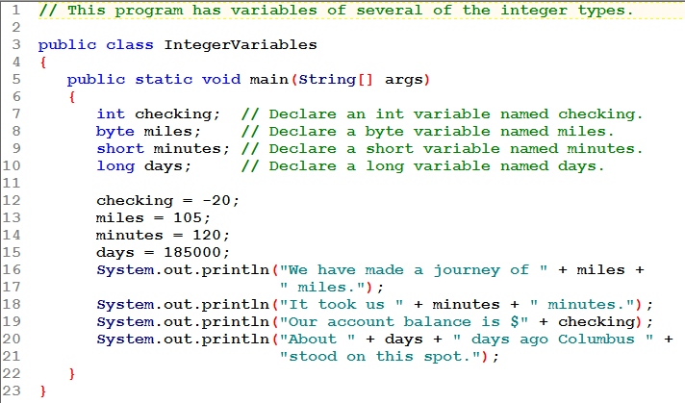
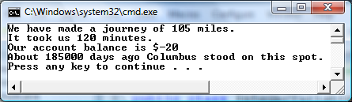

Slide 43
Floating Point Data Types
Data types that allow fractional values are called floating-point numbers.
  1.7 and -45.316 are floating-point numbers.
In Java there are two data types that can represent floating-point numbers.
  float - also called single precision (7 digits accuracy)
  double - also called double precision (15 digits accuracy).
2-<number>
Notes:
CHAPTER 2
Java Gaddis 4/e

Slide 44
Floating Point Literals
When floating point numbers are embedded into Java source code they are called floating point literals.
The default type for floating point literals is double.
  29.75, 1.76, and 31.51 are double data types.
Java is a strongly-typed language.
See example: Sale.java
2-<number>
Notes:
CHAPTER 2
Java Gaddis 4/e

Slide 45
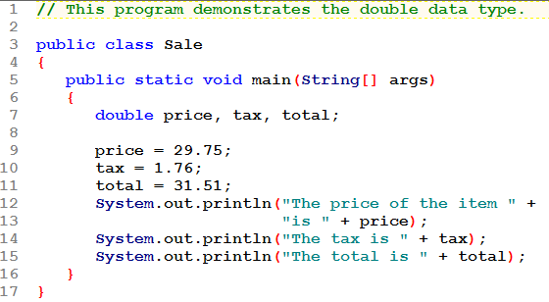
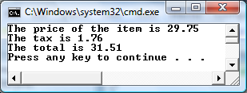

Slide 46
Floating Point Literals
A double value is not compatible with a float variable because of its size and precision.
  float number;
  number = 23.5; // Error!
A double can be forced into a float by appending the letter F or f to the literal.
  float number;
  number = 23.5F; // This will work.
2-<number>
Notes:
CHAPTER 2
Java Gaddis 4/e

Slide 47
Floating Point Literals
Literals cannot contain embedded currency symbols or commas.
  grossPay = $1,257.00; // ERROR!
  grossPay = 1257.00; // Correct.
Floating-point literals can be represented in scientific notation.
  47,281.97 → 4.728197 x 10⁴.
Java uses E notation to represent values in scientific notation.
  4.728197 x 10⁴ → 4.728197E4.
2-<number>
Notes:
CHAPTER 2
Java Gaddis 4/e

Slide 48
Scientific and E Notation
Decimal Notation | Scientific Notation | E Notation
247.91 | 2.4791 x 10² | 2.4791E2
0.00072 | 7.2 x 10⁻⁴ | 7.2E-4
2,900,000 | 2.9 x 10⁶ | 2.9E6
See example: SunFacts.java
2-<number>
Notes:
CHAPTER 2
Java Gaddis 4/e

Slide 49
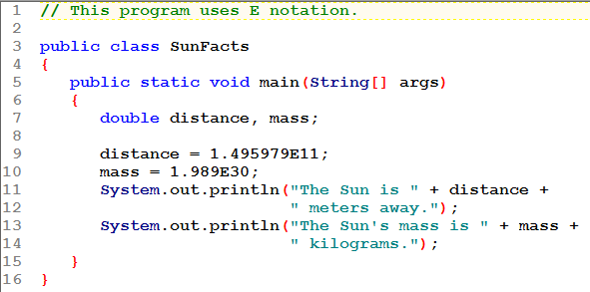
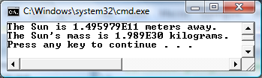

Slide 50
The boolean Data Type
The Java boolean data type can have two possible values.
  true
  false
The value of a boolean variable may only be copied into a boolean variable.
See example: TrueFalse.java
2-<number>
Notes:
CHAPTER 2
Java Gaddis 4/e

Slide 51
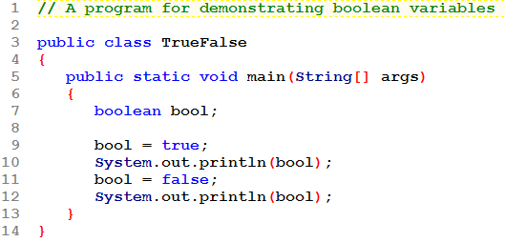
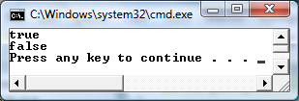

Slide 52
The char Data Type
The Java char data type provides access to single characters.
char literals are enclosed in single quote marks.
  'a', 'Z', '\n', '1'
Don't confuse char literals with string literals.
  char literals are enclosed in single quotes.
  String literals are enclosed in double quotes.
See example: Letters.java
2-<number>
Notes:
CHAPTER 2
Java Gaddis 4/e

Slide 53
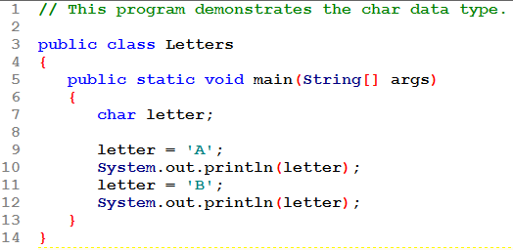
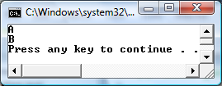

Slide 54
Unicode
Internally, characters are stored as numbers.
Character data in Java is stored as Unicode characters.
The Unicode character set can consist of 65536 (2¹⁶) individual characters.
This means that each character takes up 2 bytes in memory.
The first 256 characters in the Unicode character set are compatible with the ASCII* character set.
See example: Letters2.java
*American Standard Code for Information Interchange
2-<number>
Notes:
CHAPTER 2
Java Gaddis 4/e

Slide 55
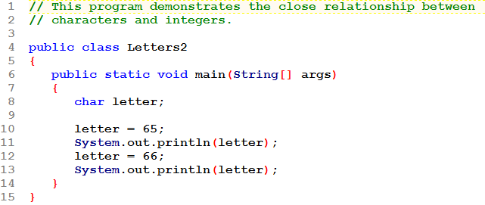
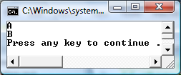
Two char variables are given integer values! When printed the appropriate character displays.

Slide 56
Unicode
A
B
00
65
00
66
0
0
0
0
0
0
0
0
0
1
0
0
0
0
0
1
0
0
0
0
0
0
0
0
0
1
0
0
0
0
1
1
2-<number>

Slide 57
Unicode
A
Characters are
stored in memory
as binary numbers.
B
00
65
00
66
0
0
0
0
0
0
0
0
0
1
0
0
0
0
0
1
0
0
0
0
0
0
0
0
0
1
0
0
0
0
1
1
2-<number>

Slide 58
Unicode
A
The binary numbers
represent these
decimal values.
B
00
65
00
66
0
0
0
0
0
0
0
0
0
1
0
0
0
0
0
1
0
0
0
0
0
0
0
0
0
1
0
0
0
0
1
1
2-<number>

Slide 59
Unicode
A
B
00
65
The decimal values
represent these
characters.
00
66
0
0
0
0
0
0
0
0
0
1
0
0
0
0
0
1
0
0
0
0
0
0
0
0
0
1
0
0
0
0
1
1
2-<number>

Slide 60
Variable Assignment and Initialization
In order to store a value in a variable, an assignment statement must be used.
The assignment operator is the equal (=) sign.
The operand on the left side of the assignment operator must be a variable name.
The operand on the right side must be either a literal or expression that evaluates to a type that is compatible with the type of the variable.
2-<number>
Notes:
CHAPTER 2
Java Gaddis 4/e

Slide 61
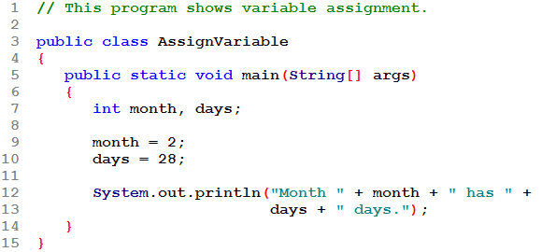
Variable Assignment and Initialization
Variables are declared but not initialized!
The variables must be declared before they can be used.
Once declared, they can then receive a value (assignment);
however the value must be compatible with the variable's
declared type.
2-<number>
Notes:
CHAPTER 2
Java Gaddis 4/e

Slide 62
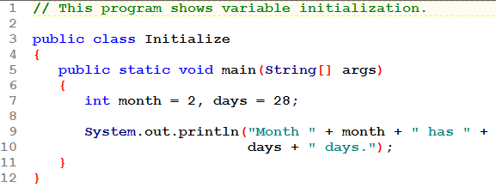
Variable Assignment and Initialization
Variables are initialized!
The variables must be declared before they can be used.
The declaration can optionally include initialization.
2-<number>
Notes:
CHAPTER 2
Java Gaddis 4/e

Slide 63
Variable Assignment and Initialization
Variables can only hold one value at a time.
Local variables do not receive a default value.
Local variables must have a valid value in order to be used. Uninitialized.java
Trying to use uninitialized variables will generate a Syntax Error when the code is compiled.
2-<number>
Notes:
CHAPTER 2
Java Gaddis 4/e

Slide 64
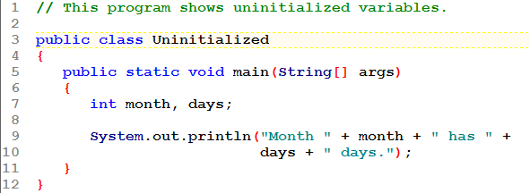
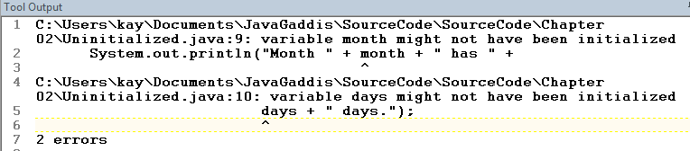

Slide 65
Arithmetic Operators
Java has five (5) arithmetic operators.
Operator | Meaning | Type | Example
+ | Addition | Binary | total = cost + tax;
- | Subtraction | Binary | cost = total – tax;
* | Multiplication | Binary | tax = cost * rate;
/ | Division | Binary | salePrice = original / 2;
% | Modulus | Binary | remainder = value % 5;
2-<number>
Notes:
CHAPTER 2
Java Gaddis 4/e

Slide 66
Arithmetic Operators
The operators are called binary operators because they must have two operands.
Each operator must have a left and right operator.
See example: Wages.java
The arithmetic operators + - * work as one would expect.
2-<number>
Notes:
CHAPTER 2
Java Gaddis 4/e

Slide 67
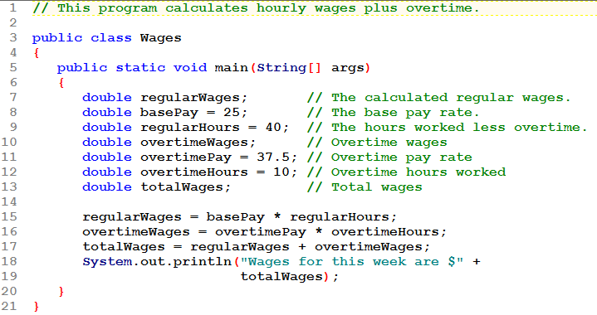


Slide 68
Division Operators / and %
There are 2 division operators
  / is the quotient operator
  % is the modulus (aka remainder) operator
The division operator (/) behaves as expected if one of the operands is a floating-point type.
When both operands are integers, the result an integer, truncated not rounded.
Hence, 99/100 has a value of 0!
2-<number>
Notes:
CHAPTER 2
Java Gaddis 4/e

Slide 69
Division Operators / and %
With int operands / gives int results.
  12 / 6 → 2
  20 / 3 → 6 // note truncation
  -24 / 9 → -2 // truncation
  15 / 30 → 0 // int result, truncation !!
An Introduction to Programming with C++, Fifth Edition

Slide 70
Division Operators / and %
With at least one double operand / gives double results.
  12.0 / 6 → 2.0
  20 / 3.0 → 6.66666666666666
  15.5 / 2.5 → 6.2
  1.5 / 30 → 0.05
An Introduction to Programming with C++, Fifth Edition

Slide 71
Division Operators / and %
The modulus (%) operator is used with integer operands to obtain the remainder after integer division.
  14 divided by 4 is 3 with a remainder of 2.
  Hence, 14 % 4 is equal to 2.
The modulus operator has many uses, including
  determining if an integer is odd or even
  determining if one integer is evenly divisible by another integer.
2-<number>
Notes:
CHAPTER 2
Java Gaddis 4/e

Slide 72
Division Operators / and %
With int operands % gives int results.
  12 % 6 → 0
  20 % 3 → 2
  -24 % 9 → -6
  15 % 30 → 15 ← Be careful with this one!
The % operator is not used with any other type of operand!
An Introduction to Programming with C++, Fifth Edition

Slide 73
Arithmetic Operators
  Try these out:
int a = 29, b = 5, c;
c = a + b; c ← ___
c = b – a; c ← ___
c = a * b; c ← ___
c = a / b; c ← ___
c = a % b; c ← ___
c = b / a; c ← ___
c = b % a; c ← ___

Slide 74
Arithmetic Operators
  Try these out:
int a = 29, b = 5, c;
c = a + b; c ← 34
c = b – a; c ← -24
c = a * b; c ← 145
c = a / b; c ← 5 (truncate)
c = a % b; c ← 4 (remainder)
c = b / a;
c = 5 / 29 c ← 0
c = b % a;
c = 5 % 29 c ← 5

Slide 75
Operator Precedence
Mathematical expressions can be very complex.
There is a set order in which arithmetic operations will be carried out.
Operator | Associativity | Example | Result
( ) | Left to right | X = 4 * (2 + 5) | 28
- (unary negation) | Right to left | x = -4 + 3; | -1
* / % | Left to right | x = -4 + 4 % 3 * 13 + 2; | 11
+ - | Left to right | x = 6 + 3 – 4 + 6 * 3; | 23
Higher
Priority
Lower
Priority
2-<number>
Notes:
CHAPTER 2
Java Gaddis 4/e

Slide 76
Operator Precedence
Evaluate these:
  int a = 24, b = 5, c;
  c = a * b – 10;
  c = 3 * ( 2 * b – 7 );
  c = - a + b / 2;
  c = b % a * 4;
Notes:
Java Gaddis 4/e
CHAPTER 2

Slide 77
Operator Precedence
Evaluate these:
  int a = 24, b = 5, c;
  c = a * b – 10; c ← 110
  c = 3 * ( 2 * b – 7 ); c ← 9
  c = - a + b / 2; c ← -22
  c = b % a * 4; c ← 20
Notes:
Java Gaddis 4/e
CHAPTER 2

Slide 78
The Math class
The Java API includes the Math class which contains several methods useful in performing mathematical calculations.
  Math.pow used to raise a value to a power:
    5³ can't be computed with a Java operator. Instead it's computed as: Math.pow(5, 3)
    Example: x = 4 * Math.pow(2.5, 3.0);
      declare x as a double
  Math.sqrt used to find a square root:
    Example: x = Math.sqrt(7.5);
      declare x as a double

Slide 79
Combined Assignment Operators
Java has some combined assignment operators.
These operators allow the programmer to perform an arithmetic operation and assignment with a single operator.
Although not required, these operators are popular since they shorten simple equations.
2-<number>
Notes:
CHAPTER 2
Java Gaddis 4/e

Slide 80
Combined Assignment Operators
Operator | Example | Equivalent | Value of variable after operation
+= | x += 5; | x = x + 5; | The old value of x plus 5.
-= | y -= 2; | y = y – 2; | The old value of y minus 2
*= | z *= 10; | z = z * 10; | The old value of z times 10
/= | a /= b; | a = a / b; | The old value of a divided by b.
%= | c %= 3; | c = c % 3; | The remainder of the division of the old value of c divided by 3.
2-<number>
Notes:
CHAPTER 2
Java Gaddis 4/e

Slide 81
Conversion between Primitive Data Types
Java is said to be strongly typed.
  You can't, for example, assign a floating point value to a variable declared to store an integer.
  int value;
  value = 2.5; // ERROR: you can't assign an double
  // value to an int variable
Sometimes conversions between numbers are possible.
  double rate;
  rate = 7; // It is OK to assign an int value to a
  // double variable

Slide 82
Conversion between Primitive Data Types
A value of one type can be assigned to a variable of any type further to the right
byte → short → int → long
→ float → double
  But not to a variable of any type further to the left.
You can also assign a value of type char to a variable of type int.

Slide 83
Cast Operators
A type cast lets you manually convert a value, even if it means that a narrowing conversion will take place.
For example,
double distance;
distance = 9.7;
int points;
points = (int)distance; // the type cast
Illegal without the type cast: (int)
Result: points ← 9 (truncates the fractional part)
*** distance is STILL a double with value 9.7

Slide 84
Creating Constants
Many programs have data that does not need to be changed.
Littering programs with literal values can make the program hard do read and maintain.
Replacing literal values with constants remedies this problem.
Constants allow the programmer to use a name rather than a value throughout the program.
Constants also give a singular point for changing those values when needed.
2-<number>
Notes:
CHAPTER 2
Java Gaddis 4/e

Slide 85
Creating Constants
Constants keep the program organized and easier to maintain.
Constants are identifiers that can hold only a single value.
Constants are declared using the keyword final.
Constants need not be initialized when declared; however, they must be initialized before they are used or a compiler error will be generated.
2-<number>
Notes:
CHAPTER 2
Java Gaddis 4/e

Slide 86
Creating Constants
Once initialized with a value, constants cannot be changed programmatically.
By convention, constants are all upper case and words are separated by the underscore character.
  final int CAL_SALES_TAX = 0.725;
2-<number>
Notes:
CHAPTER 2
Java Gaddis 4/e

Slide 87
The String Class
Java has no primitive data type that holds a series of characters.
The String class from the Java standard library is used for this purpose.
In order to be useful, the a variable must be created to reference a String object.
  String number;
Notice the S in String is upper case.
By convention, class names should always begin with an upper case character.
2-<number>
Notes:
CHAPTER 2
Java Gaddis 4/e

Slide 88
Primitive vs. Reference Variables
Primitive variables actually contain the value that they have been assigned.
  number = 25;
The value 25 will be stored in the memory location associated with the variable number.
Objects are not stored in variables, however. Objects are referenced by variables.
2-<number>
Notes:
CHAPTER 2
Java Gaddis 4/e

Slide 89
Primitive vs. Reference Variables
When a variable references an object, it contains the memory address of the object's location.
Then it is said that the variable references the object.
  String cityName = "Charleston";
The object that contains the
character string “Charleston”
Charleston
cityName
Address to the object
2-<number>
Notes:
CHAPTER 2
Java Gaddis 4/e

Slide 90
String Objects
A variable can be assigned a String literal.
  String value = "Hello";
Strings are the only objects that can be created in this way.
A variable can also be created using the new keyword.
  String value = new String("Hello");
This is the method that all other objects must use when they are created.
See example: StringDemo.java
2-<number>
Notes:
CHAPTER 2
Java Gaddis 4/e

Slide 91
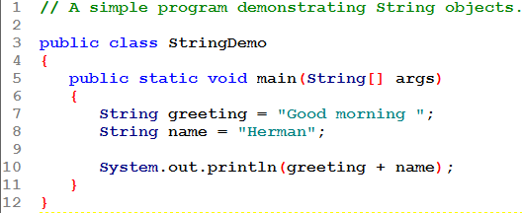
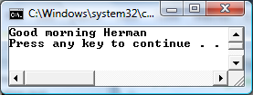

Slide 92
The String Methods
Since String is a class, objects that are instances of it have methods.
One of those methods is the length method.
  stringSize = value.length();
This statement runs the length method on the object pointed to by the value variable.
See example: StringLength.java
2-<number>
Notes:
CHAPTER 2
Java Gaddis 4/e

Slide 93
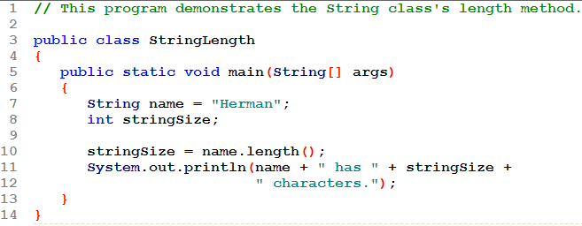


Slide 94
String Methods
The String class contains many methods that help with the manipulation of String objects.
String objects are immutable, meaning that they cannot be changed.
Many of the methods of a String object can create new versions of the object.
See Table 2-15 for a few String class methods.
See example: StringMethods.java
2-<number>
Notes:
CHAPTER 2
Java Gaddis 4/e

Slide 95
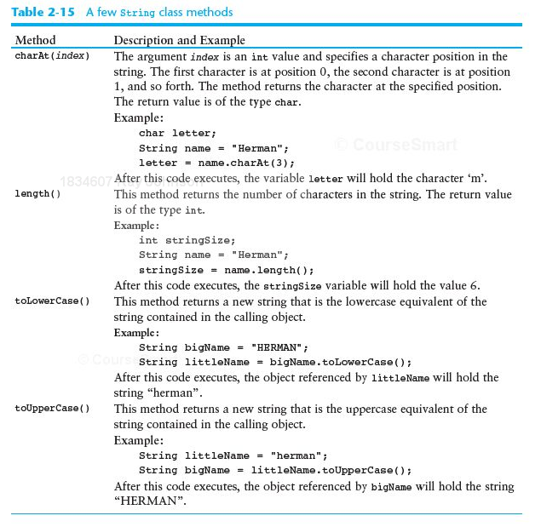

Slide 96
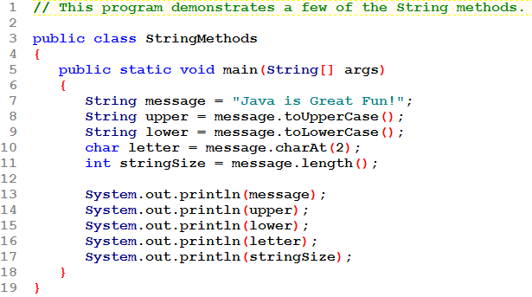
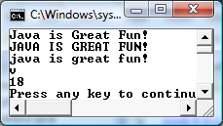
This is NOT changed by any of the methods used with it.

Slide 97
The Scanner Class
To read input from the keyboard we can use the Scanner class.
The Scanner class is defined in java.util, so we will use the following statement at the top of our programs:
import java.util.Scanner;
2-<number>
Notes:
CHAPTER 2
Java Gaddis 4/e

Slide 98
The Scanner Class
Scanner objects work with System.in
To create a Scanner object:
Scanner keyboard = new Scanner (System.in);
Scanner class methods are listed in Table 2-17 in the text.
See example: Payroll.java
2-<number>
Notes:
CHAPTER 2
Java Gaddis 4/e

Slide 99
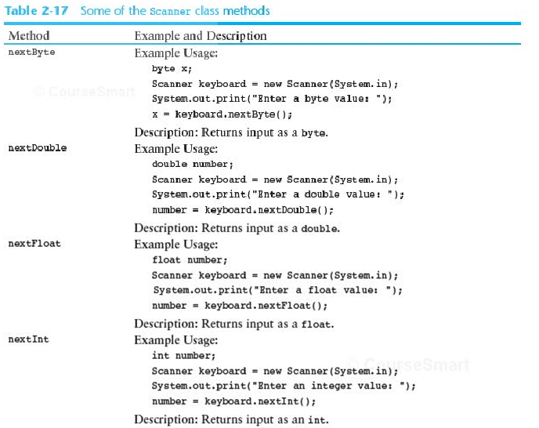

Slide 100
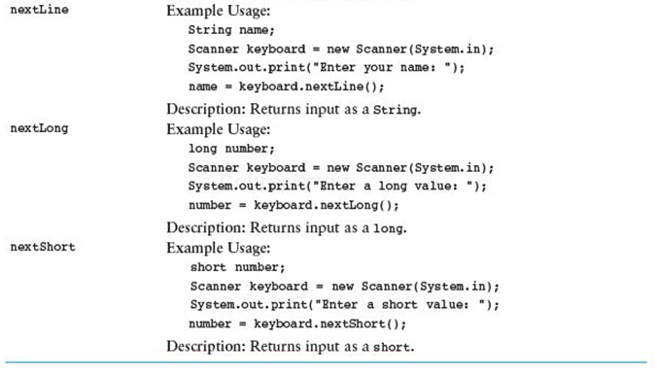

Slide 101
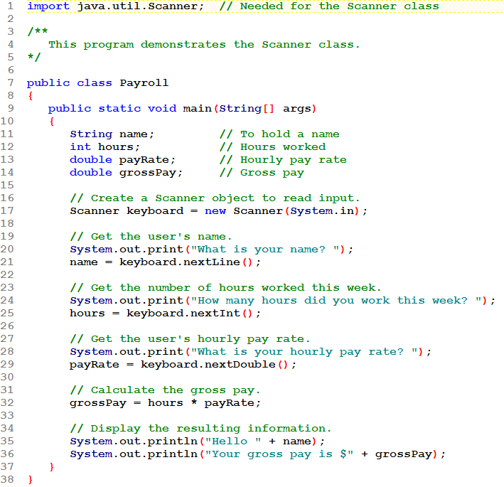

Slide 102
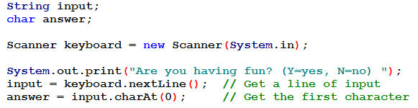
The Scanner Class
There is no method provided to read a single character from the keyboard.
Our approach requires two steps:
  First read a string from the keyboard
  Then use the String class method charAt to extract the first character of the string.
2-<number>
Notes:
CHAPTER 2
Java Gaddis 4/e

Slide 103
The Scanner Class
There can be a problem when you read a primitive value (such as using nextInt or nextDouble) and then call nextLine to read a string.
Example: InputProblem.java
Note that in the screenshot of the system console, once the prompt asking the user to enter a name has been displayed, there seems to be no input from the user! Without waiting for user input, the program displays the output that should follow. Where the name should be displayed, nothing is shown.
2-<number>
Notes:
CHAPTER 2
Java Gaddis 4/e

Slide 104
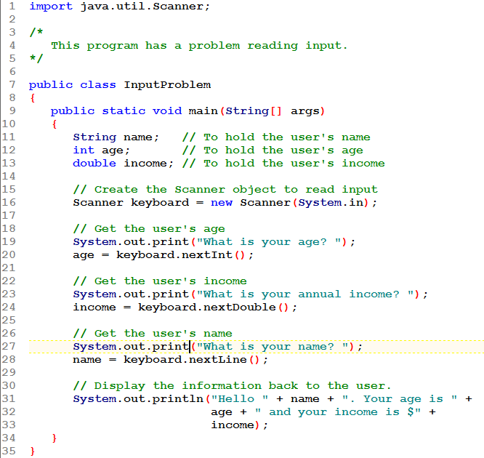
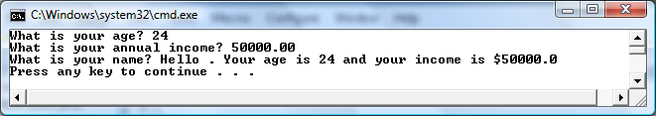

Slide 105
The Scanner Class
Explanation: Please see the text (p 90) for a full explanation. In brief, the problem is a newline character that is left in the input stream after a primitive value is read.
  When reading a primitive (using something such as nextInt or nextDouble) any whitespace at the beginning of the input stream is ignored; the newline at the end of the input stream is left in the input stream.
  When the nextLine method executes, it sees that newline as actual (empty) String input!
2-<number>
Notes:
CHAPTER 2
Java Gaddis 4/e

Slide 106
The Scanner Class
Solution: We need to remove the newline from the input stream. A simple statement that "reads" it and then doesn't do anything with it will suffice.
  The statement "keyboard.nextLine();" will do exactly that.
  Note that we are not assigning its return value to a variable. We don't need to do that. We just "read" it and "ignore" it.
Note that this is only necessary when following the reading of a primitive with the reading of a String.
Example: CorrectedInputProblem.java
2-<number>
Notes:
CHAPTER 2
Java Gaddis 4/e

Slide 107
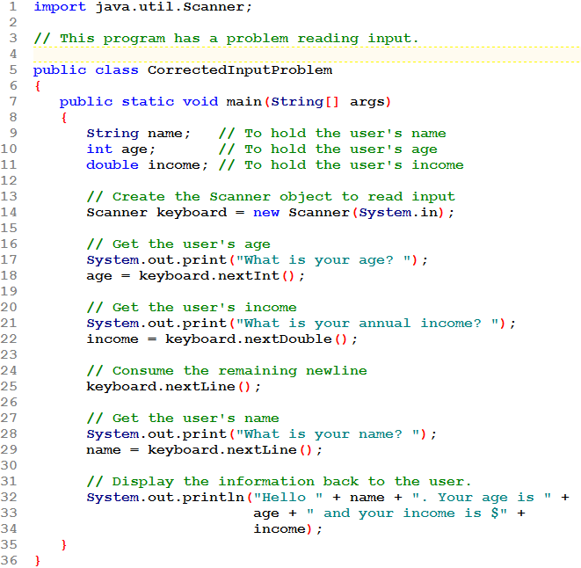
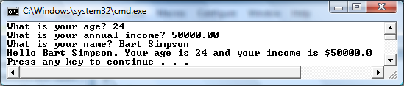

Slide 108
Scope
Scope refers to the part of a program that has access to a variable's contents.
Variables declared inside a method (like the main method) are called local variables.
Local variables' scope begins at the declaration of the variable and ends at the end of the method in which it was declared.
See example: Scope.java (This program contains an intentional error.)
2-<number>
Notes:
CHAPTER 2
Java Gaddis 4/e

Slide 109
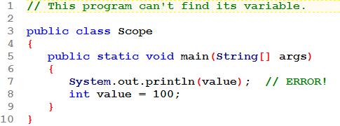
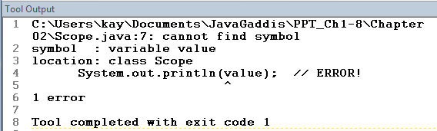

Slide 110
Commenting Code
Java provides three methods for commenting code.
Comment Style | Description
// | Single line comment. Anything after the // on the line will be ignored by the compiler.
/* … */ | Block comment. Everything beginning with /* and ending with the first */ will be ignored by the compiler. This comment type cannot be nested.
/** … */ | Javadoc comment. This is a special version of the previous block comment that allows comments to be documented by the javadoc utility program. Everything beginning with the /** and ending with the first */ will be ignored by the compiler. This comment type cannot be nested.
2-<number>
Notes:
CHAPTER 2
Java Gaddis 4/e

Slide 111
Commenting Code
Javadoc comments can be built into HTML documentation.
See example: Comment3.java
To create the documentation:
  Run the javadoc program with the source file as an argument
  Ex: javadoc Comment3.java
The javadoc program will create index.html and several other documentation files in the same directory as the input file.
2-<number>
Notes:
CHAPTER 2
Java Gaddis 4/e

Slide 112
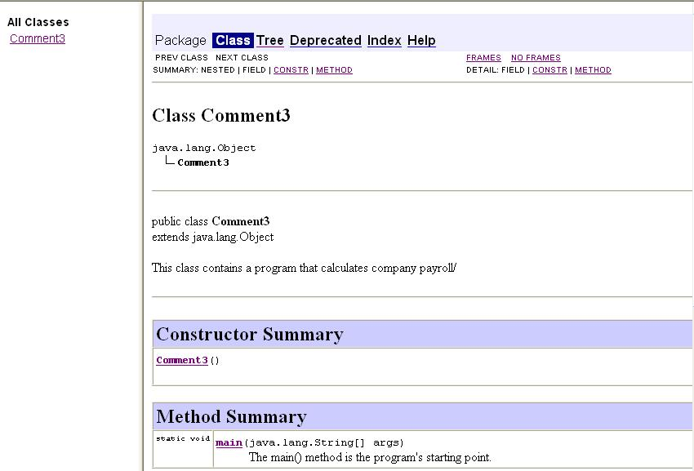
Commenting Code
Example index.html:
2-<number>
Notes:
CHAPTER 2
Java Gaddis 4/e

Slide 113
Programming Style
Although Java has a strict syntax, whitespace characters are ignored by the compiler.
The Java whitespace characters are:
  space
  tab
  newline
  carriage return
  form feed
2-<number>
Notes:
CHAPTER 2
Java Gaddis 4/e

Slide 114
Indentation
Programs should use proper indentation.
Each block of code should be indented a few spaces from its surrounding block.
Two to four spaces are sufficient.
Tab characters should be avoided.
  Tabs can vary in size between applications and devices.
  Most programming text editors allow the user to replace the tab with spaces.
See example: Compact.java
See example: Readable.java
2-<number>
Notes:
CHAPTER 2
Java Gaddis 4/e

Slide 115

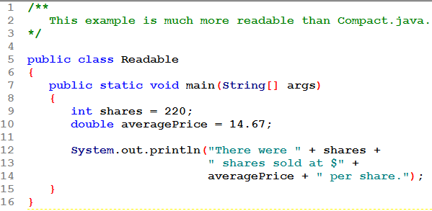


Slide 116
Dialog Boxes
A dialog box is a small graphical window that displays a message to the user or requests input.
A variety of dialog boxes can be displayed using the JOptionPane class.
Two of the dialog boxes are:
  Message Dialog: a dialog box that displays a message.
  Input Dialog: a dialog box that prompts the user for input.
2-<number>
Notes:
CHAPTER 2
Java Gaddis 4/e

Slide 117
The JOptionPane Class
The JOptionPane class is not automatically available to your Java programs.
The following statement must be before the program's class header:
  import javax.swing.JOptionPane;
This statement tells the compiler where to find the JOptionPane class.
2-<number>
Notes:
CHAPTER 2
Java Gaddis 4/e

Slide 118
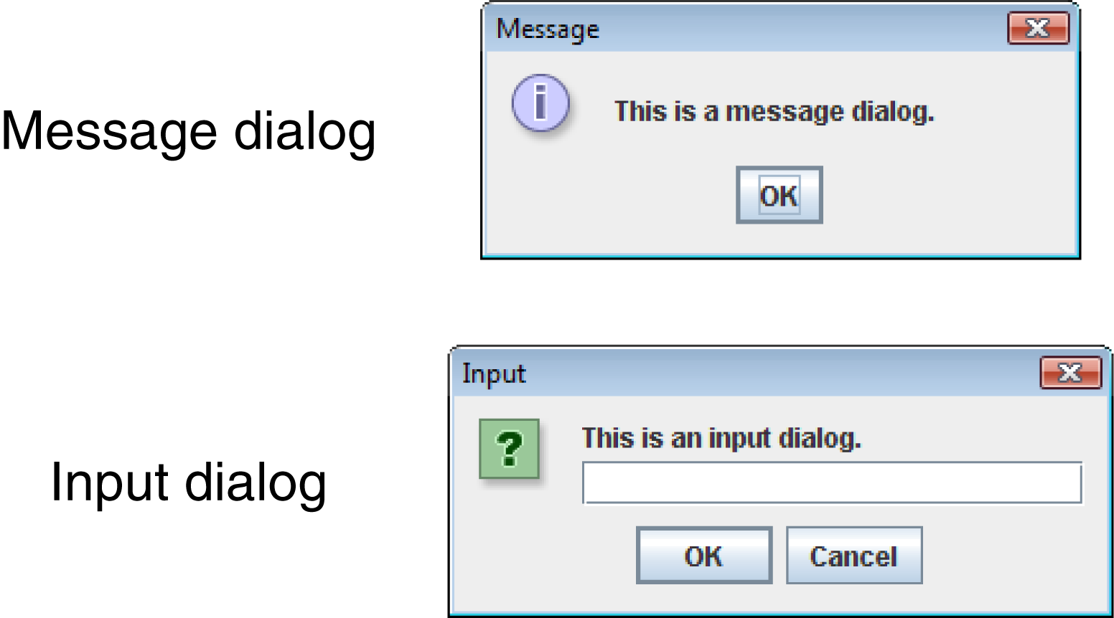
The JOptionPane Class
The JOptionPane class provides methods to display each type of dialog box.
2-<number>
Notes:
CHAPTER 2
Java Gaddis 4/e

Slide 119
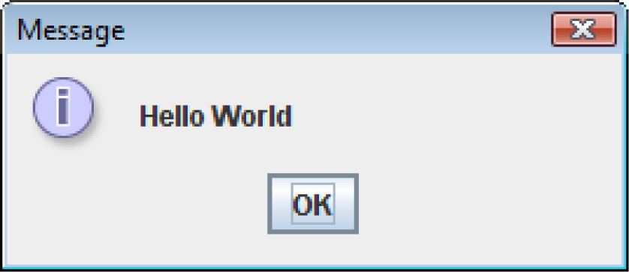
Message Dialogs
JOptionPane.showMessageDialog method is used to display a message dialog.
  JOptionPane.showMessageDialog(null, "Hello World");
The first argument will be discussed in Chapter 7.
The second argument is the message that is to be displayed.
2-<number>
Notes:
CHAPTER 2
Java Gaddis 4/e

Slide 120
Input Dialogs
An input dialog is a quick and simple way to ask the user to enter data.
The dialog displays a text field, an Ok button and a Cancel button.
If Ok is pressed, the dialog returns the user's input.
If Cancel is pressed, the dialog returns null.
2-<number>
Notes:
CHAPTER 2
Java Gaddis 4/e

Slide 121
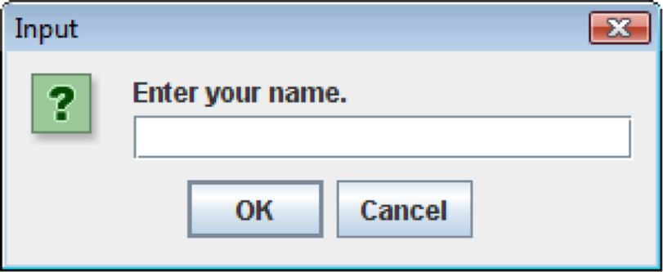
Input Dialogs
  String name;
  name = JOptionPane.showInputDialog(
  "Enter your name.");
The argument passed to the method is the message to display.
If the user clicks on the OK button, name references the string entered by the user.
If the user clicks on the Cancel button, name references null.
2-<number>
Notes:
CHAPTER 2
Java Gaddis 4/e

Slide 122
The System.exit Method
A program that uses JOptionPane does not automatically stop executing when the end of the main method is reached.
Java generates a thread, which is a process running in the computer, when a JOptionPane is created.
If the System.exit method is not called, this thread continues to execute.
2-<number>
Notes:
CHAPTER 2
Java Gaddis 4/e

Slide 123
The System.exit Method
The System.exit method requires an integer argument.
  System.exit(0);
This argument is an exit code that is passed back to the operating system.
This code is usually ignored, however, it can be used outside the program:
  to indicate whether the program ended successfully or as the result of a failure.
  The value 0 traditionally indicates that the program ended successfully.
2-<number>
Notes:
CHAPTER 2
Java Gaddis 4/e

Slide 124
Converting a String to a Number
The JOptionPane's showInputDialog method always returns the user's input as a String
A String containing a number, such as "127.89", can be converted to a numeric data type.
2-<number>
Notes:
CHAPTER 2
Java Gaddis 4/e

Slide 125
The Parse Methods
Each of the numeric wrapper classes, (covered in Chapter 10) has a method that converts a string to a number.
  The Integer class has a method that converts a string to an int,
  The Double class has a method that converts a string to a double, and
  etc.
These methods are known as parse methods because their names begin with the word "parse."
2-<number>
Notes:
CHAPTER 2
Java Gaddis 4/e

Slide 126
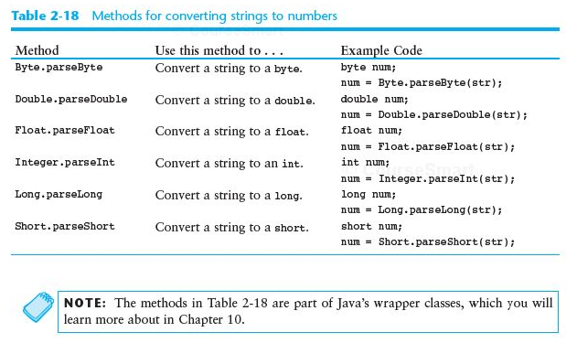

Slide 127
Reading an int with an Input Dialog
int number;
String str;
str = JOptionPane.showInputDialog(
"Enter a number.");
number = Integer.parseInt(str);
2-<number>
Notes:
CHAPTER 2
Java Gaddis 4/e

Slide 128
Reading a double with an Input Dialog
double price;
String str;
str = JOptionPane.showInputDialog(
"Enter the retail price.");
price = Double.parseDouble(str);
See example: PayrollDialog.java
2-<number>
Notes:
CHAPTER 2
Java Gaddis 4/e

Slide 129
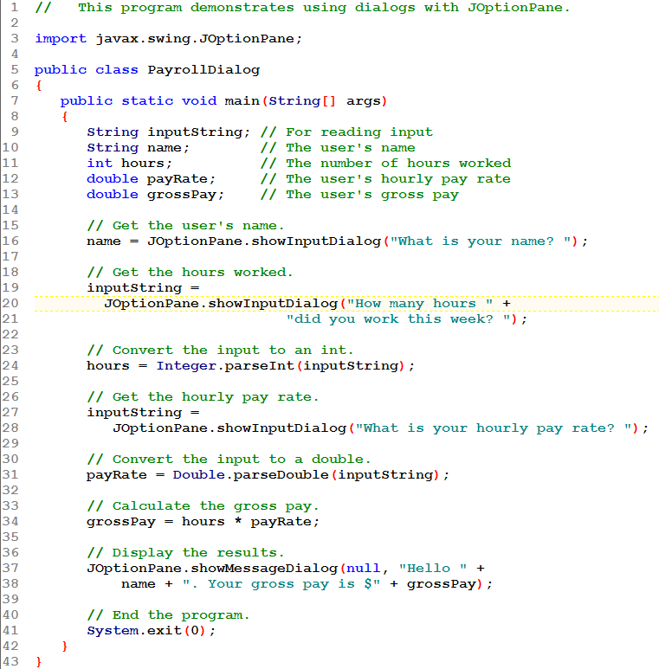





Slide 130
END CHAPTER 2

